Slide 1
Getting Started with the ACF UTK and UTHSC’s computing cluster
COSC 594 Evidence Engineering
Trish Goedecke

Slide 2
Edit SSH configuration file
For UNIX-based SSH clients, the following line should be in either the default ssh_config file or your $HOME/.ssh/config file:
PreferredAuthentications keyboard-interactive,password
Windows users may obtain free SSH clients online, such as PuTTY
See instruction page:
https://www.nics.tennessee.edu/getting-started/access

Slide 3
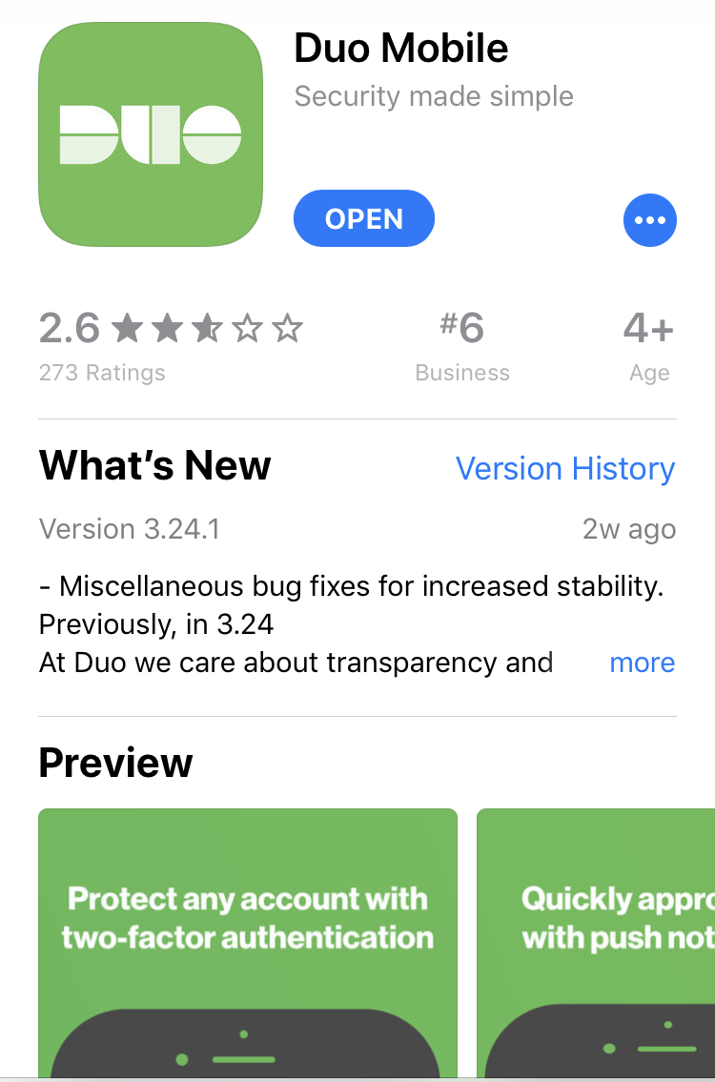
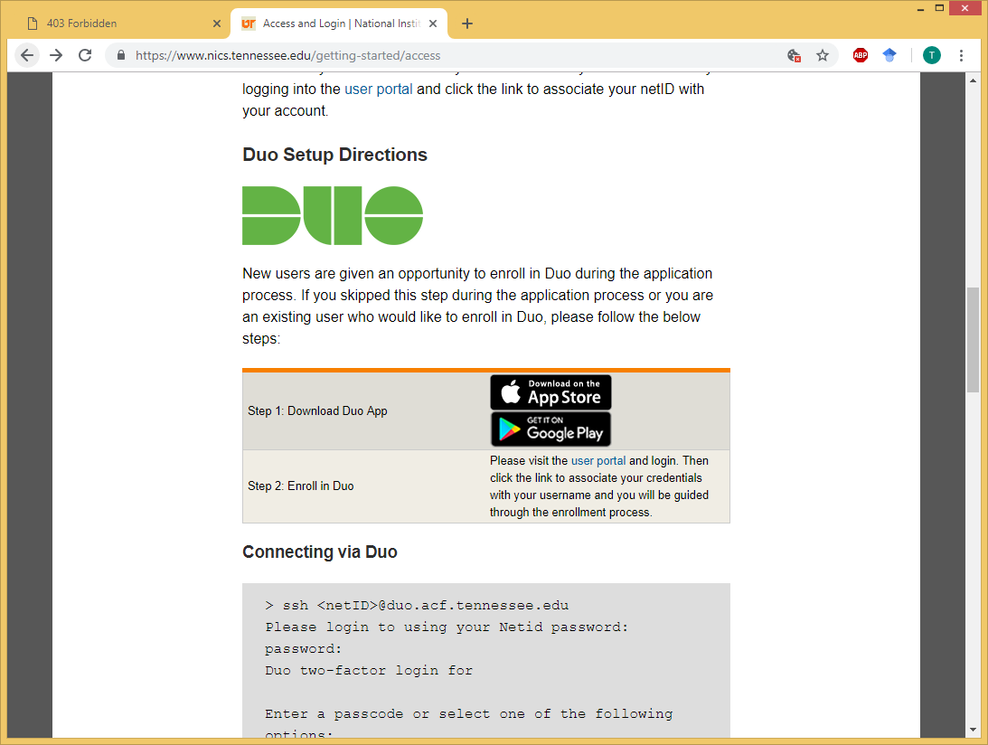
Download Duo Mobile
UT’s phone app for user authorization

Slide 4
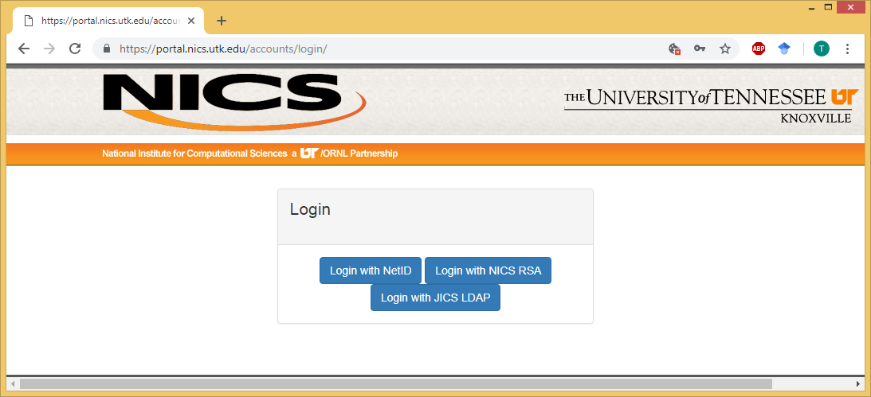
Log in using NetID to apply for an account
https://portal.nics.utk.edu/accounts/login/

Slide 5
Upload code and data file from local folder
$ scp -r /path/of/folder/to/upload/* <NetID>@duo.acf.utk.edu:/nics/d/home/<NetID>/dirname
Example :
$ scp -r ~/mini_data/* pgoedec1@duo.acf.utk.edu:/nics/d/home/pgoedec1/git_data/
Notes:
In this case, I had created the git_data directory in advance on the ACF: $ mkdir git_data
Completion of upload requires login using NetID password and Duo verification
Notes:
If asked “Are you sure you want to continue connecting (yes/no)?” type “yes”
Check present working directory ("pwd") to determine path of folder to upload

Slide 6
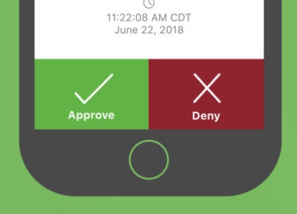
Log in!
In Terminal, type:
> ssh <NetID>@duo.acf.utk.edu
Enter NetID Password
For Duo authentification (1-1), type 1
Check Duo on phone, select “Approve”
Notes:
nics.utk.edu instructions: “ssh <netID>@duo.acf.tennessee.edu”
(http://www.nics.utk.edu/getting-started/access)
Sometimes tennessee.edu works; sometimes it doesn’t

Slide 7
Run simple code for practice
$ module load r
$ Rscript filenam.R
$ module avail
to see list of available programs

Slide 8
Using R packages on ACF
Upload the package to the ACF
Do not need to install uploaded package
In loading the package, refer to the package path, eg:
library(skimr, lib = "//nics//d//home//<NetID>//dirname")

Slide 9
Need help?
For help contact: help@nics.utk.edu

